Slide 1
Image Resizing and Image Matting
Ruyue Yan and Zhengkun Yu

Slide 2

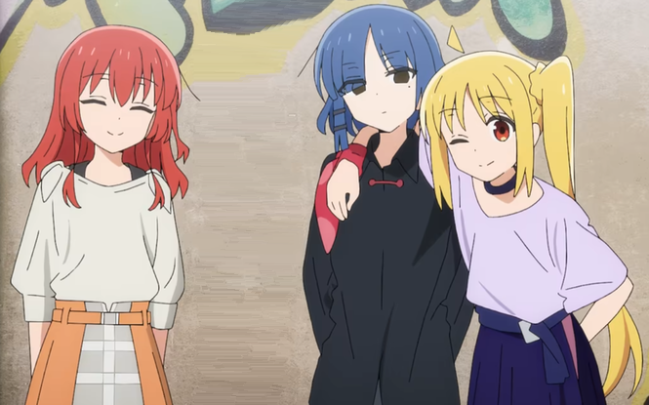
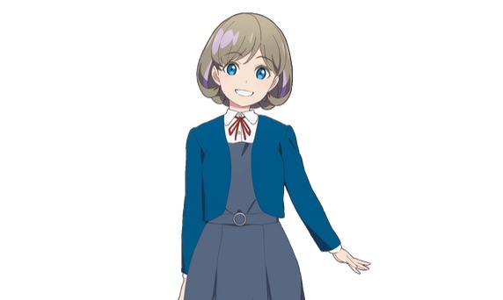

Steps
Expand the background
Extract the foreground
Integrate the foreground and the background image

Slide 3
Step1:Expand the background
We expand the background image using the seam carving algorithm.
Steps:
Energy function calculation
Seam Identification
Seam removal or insertion

Slide 4
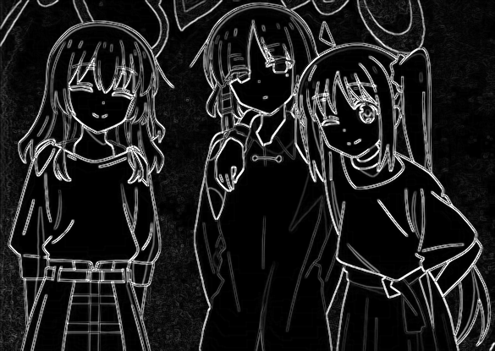
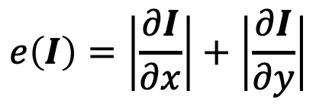
Energy function calculation
We use sobel operator to calculate energy and detect the edges.
$$e\left(I\right)=\left|\frac{∂I}{∂x}\right|+\left|\frac{∂I}{∂y}\right|$$

Slide 5
Seam Identification
We use seam carving algorithm to resize the image.
To find the optimal seam, M(i, j) = e(i, j)+min(M(i - 1, j - 1), M(i - 1, j), M(i - 1, j + 1))
5 | 10 | 12 | 3 | 7
0 | 3 | 13 | 5 | 8
1 | 10 | 4 | 16 | 2
9 | 6 | 14 | 2 | 10
3 | 0 | 18 | 13 | 2
5 | 10 | 12 | 3 | 7
5 | 8 | 16 | 8 | 11
6 | 15 | 12 | 24 | 10
15 | 12 | 26 | 12 | 20
15 | 12 | 30 | 25 | 14
0 | 0 | 0 | 0 | 0
0 | -1 | 1 | 0 | -1
0 | -1 | -1 | 0 | -1
0 | -1 | 0 | 1 | 0
1 | 0 | -1 | 0 | -1
energy
energy accumulation
path

Slide 6
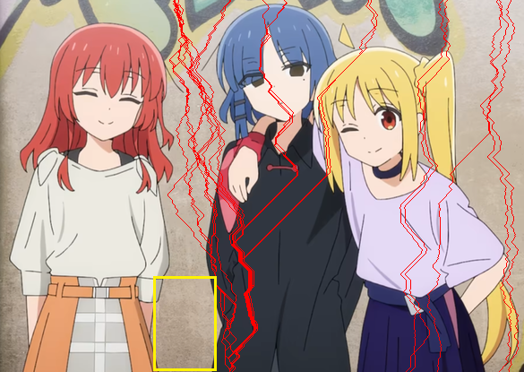
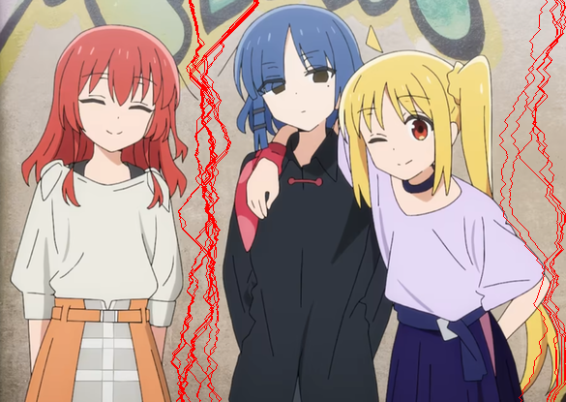
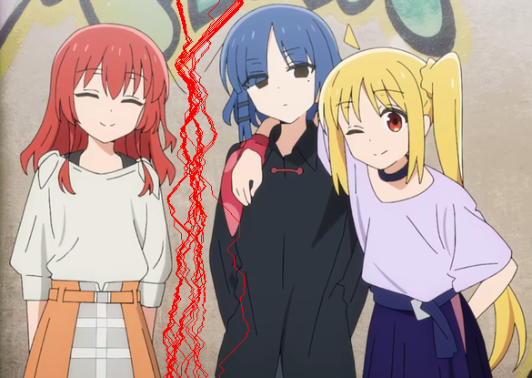
Seam Identification
We use seam carving algorithm to resize the image.
To find the optimal seam, M(i, j) = e(i, j)+min(M(i - 1, j - 1), M(i - 1, j), M(i - 1, j + 1))

Slide 7

Seam removal or insertion

Slide 8
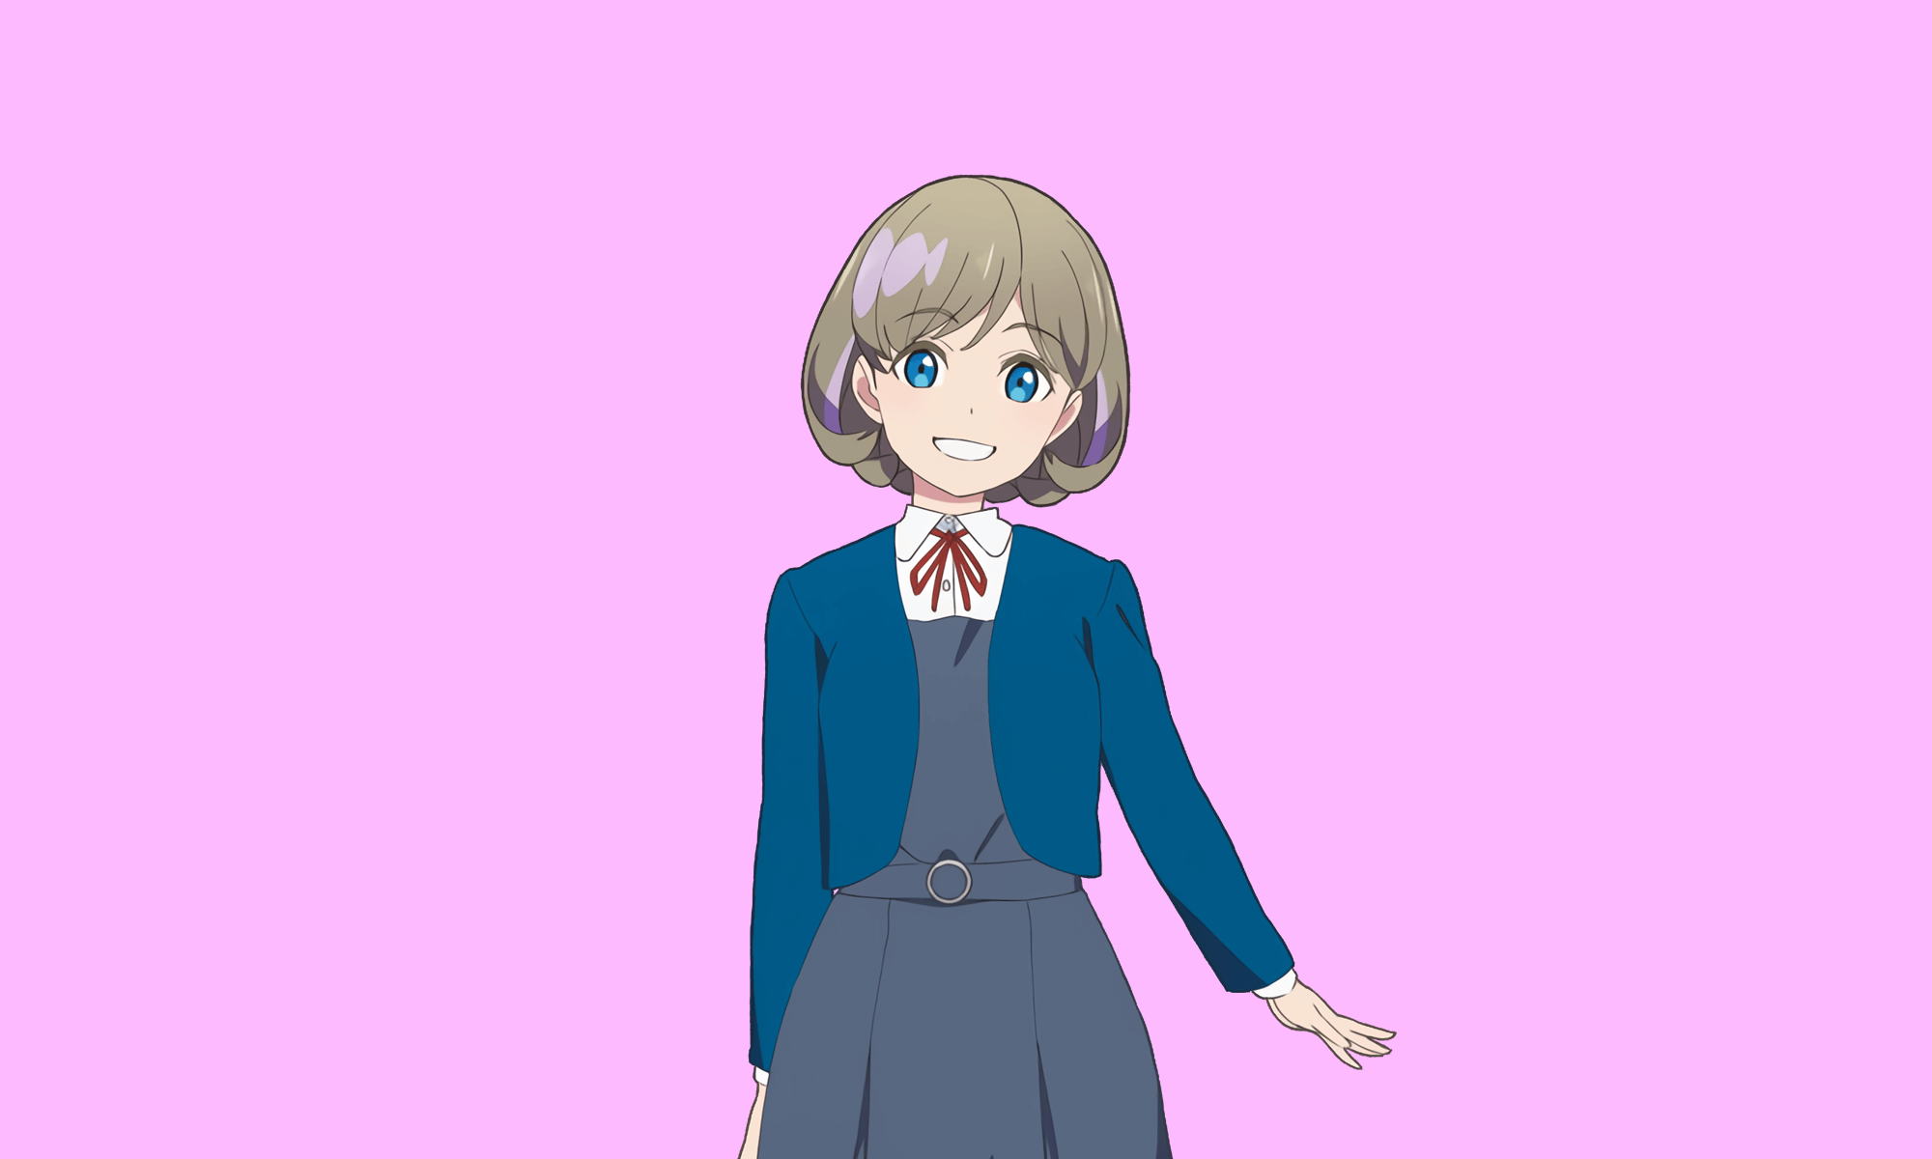

Step2: Extract the foreground
We extract the foreground image using the hole filling based on morphological reconstruction.
Steps:
Get the mask image using hole filling
Extract the foreground image using the mask

Slide 9
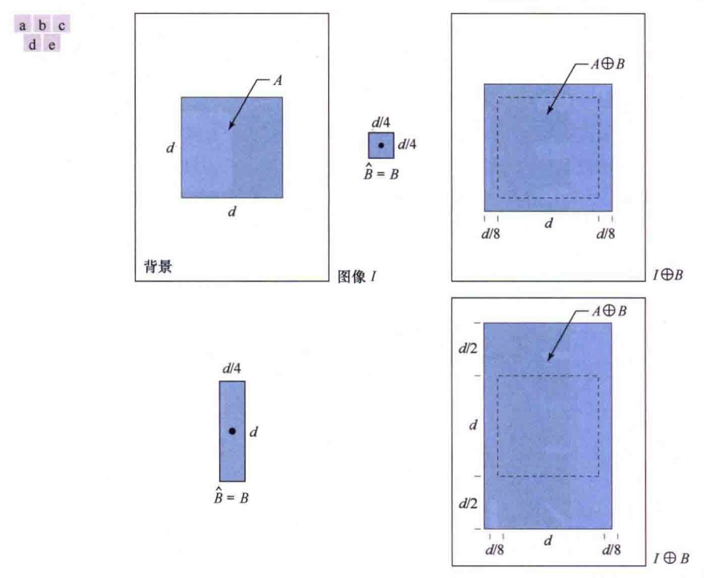

Dilation

Slide 10

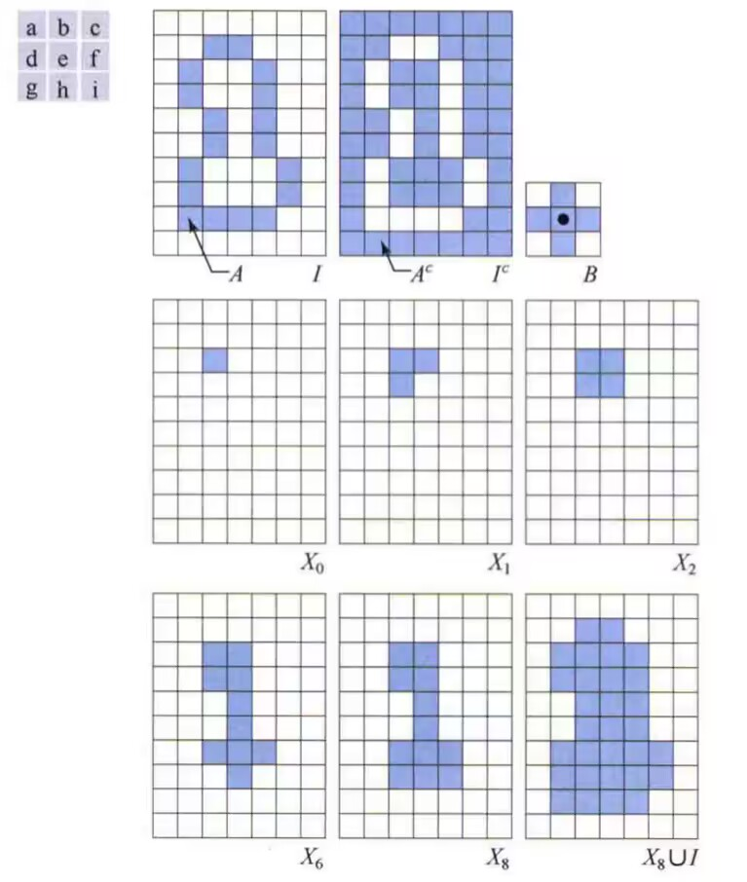
Hole Filling

Slide 11
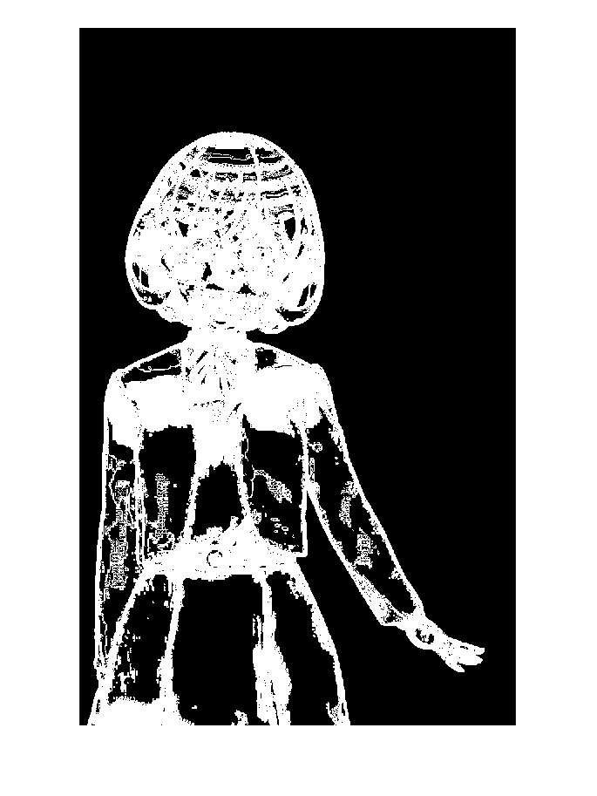
Hole Filling

Slide 12
Step3: Integrate the foreground and the background image
We scale the background and foreground images, and merge them into one image.

Slide 13
Thanks for listening!

